Slide 1

Operating Systems
Unit-2
Submitted by
Meghna Sharma

Slide 2
UNIT 2
Process Management-Process & Threads,
Process States - Process Control Block,
Process Scheduling – Operations on Processes, Threads, CPU Scheduler –Preemptive and Non- Preemptive;
Dispatcher, Scheduling
Criteria, Scheduling Algorithms ,
Process Management in UNIX

Slide 3
Processes and Threads
2.1 Processes
2.2 Threads
2.3 Scheduling Concepts
2.4 CPU Scheduler
2.5 Dispatcher
2.6 Scheduling Criteria
2.7 Scheduling Algorithms
FCFS
SJF
RR
Priority
2.8 Process Management in Unix

Slide 4

2.1Processes
The Process Model
Multiprogramming of four programs
Conceptual model of 4 independent, sequential processes
Only one program active at any instant

Slide 5
6.2 Programs and Processes
On disk
Static
No state
  No PC
  No register usage
Fixed size
In memory (and disk)
Dynamic – changing
State
  PC
  Registers
May grow or shrink
Fundamental unit of scheduling
Program
One program may
yield many processes
Process

Slide 6
6.2 Programs and Processes
Name | Usual Connotation | Use in this chapter
Job | Unit of scheduling | Synonymous with process
Process | Program in execution; unit of scheduling | Synonymous with job
Thread | Unit of scheduling and/or execution; contained within a process | Not used in the scheduling algorithms described in this chapter
Task | Unit of work; unit of scheduling | Not used in the scheduling algorithms described in this chapter, except in describing the scheduling algorithm of Linux

Slide 7
Process Creation
Principal events that cause process creation
System initialization
Execution of a process creation system
User request to create a new process
Initiation of a batch job

Slide 8
Process Termination
Conditions which terminate processes
Normal exit (voluntary)
Error exit (voluntary)
Fatal error (involuntary)
Killed by another process (involuntary)

Slide 9
Process Hierarchies
Parent creates a child process, child processes can create its own process
Forms a hierarchy
  UNIX calls this a "process group"
Windows has no concept of process hierarchy
  all processes are created equal

Slide 10
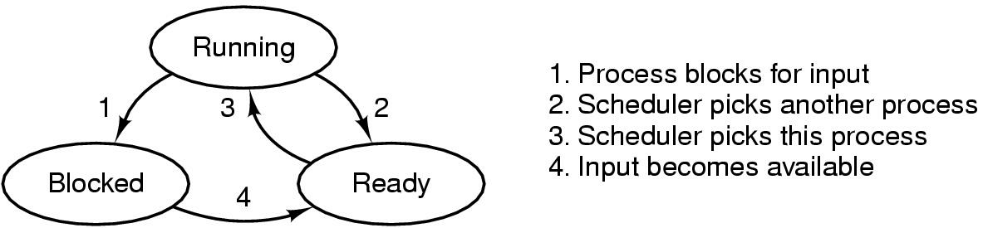
Process States (1)
Possible process states
  running
  blocked
  ready
Transitions between states shown

Slide 11
Process Concept
An operating system executes a variety of programs:
  Batch system – jobs
  Time-shared systems – user programs or tasks
Textbook uses the terms job and process almost interchangeably.
Process – a program in execution; process execution must progress in sequential fashion.
A process includes:
  program counter
  stack
  data section
Operating System Concepts

Slide 12
Process State
As a process executes, it changes state
  new: The process is being created.
  running: Instructions are being executed.
  waiting: The process is waiting for some event to occur.
  ready: The process is waiting to be assigned to a process.
  terminated: The process has finished execution.
Operating System Concepts

Slide 13

Diagram of Process State
Operating System Concepts

Slide 14
Process Control Block (PCB)
Information associated with each process.
Process state
Program counter
CPU registers
CPU scheduling information
Memory-management information
Accounting information
I/O status information
Operating System Concepts

Slide 15

Process Control Block (PCB)
Operating System Concepts

Slide 16

CPU Switch From Process to Process
Operating System Concepts

Slide 17
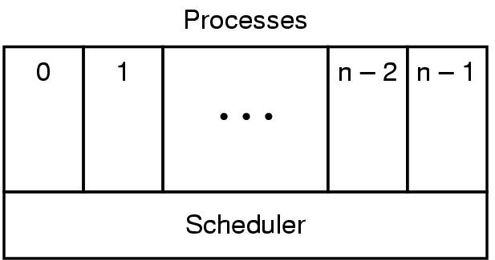
Process States (2)

Slide 18
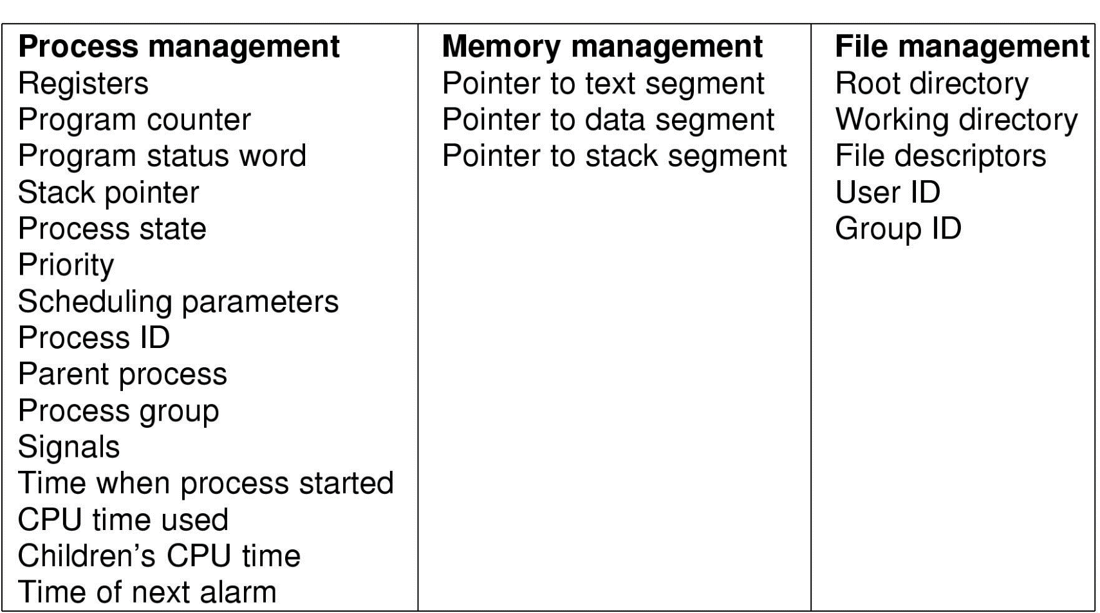
Implementation of Processes (1)
Fields of a process table entry

Slide 19
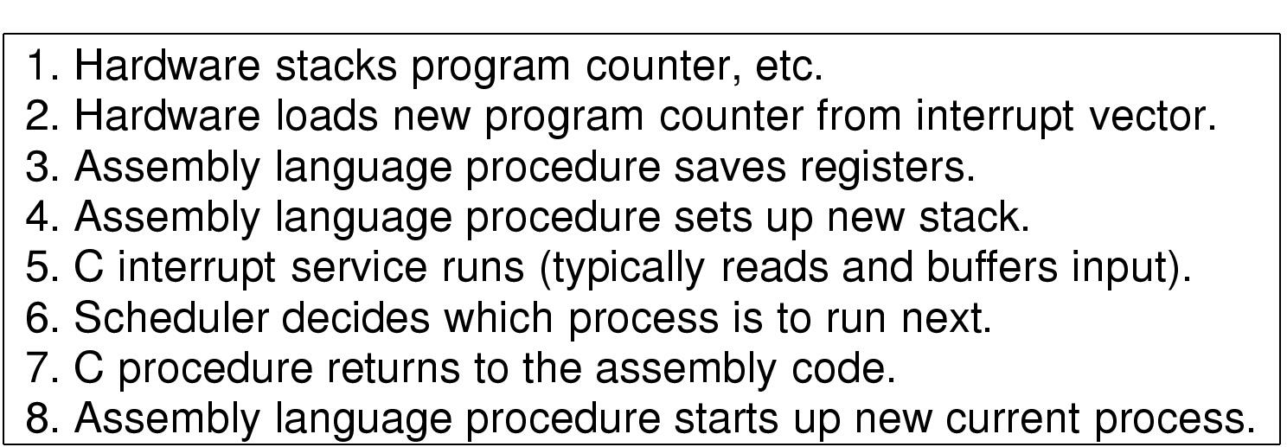
Implementation of Processes (2)
Skeleton of what lowest level of OS does when an interrupt occurs

Slide 20
2.2What is Thread?
A thread is a flow of execution through the process code, with its own program counter that keeps track of which instruction to execute next, system registers which hold its current working variables, and a stack which contains the execution history.
A thread shares with its peer threads few information like code segment, data segment and open files. When one thread alters a code segment memory item, all other threads see that.
A thread is also called a lightweight process. Threads provide a way to improve application performance through parallelism. Threads represent a software approach to improving performance of operating system by reducing the overhead thread is equivalent to a classical process.
Each thread belongs to exactly one process and no thread can exist outside a process. Each thread represents a separate flow of control. Threads have been successfully used in implementing network servers and web server. They also provide a suitable foundation for parallel execution of applications on shared memory multiprocessors. The following figure shows the working of a single-threaded and a multithreaded process.

Slide 21
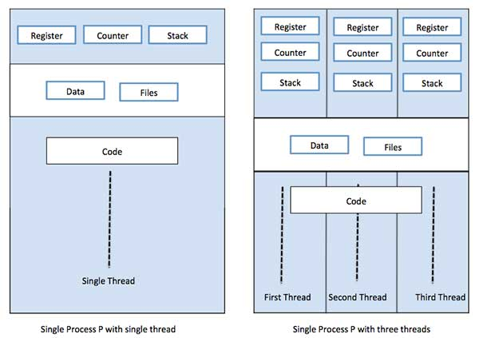

Slide 22
Benefits of Threads
Enhanced throughput of the system: When the process is split into many threads, and each thread is treated as a job, the number of jobs done in the unit time increases. That is why the throughput of the system also increases.
Effective Utilization of Multiprocessor system: When you have more than one thread in one process, you can schedule more than one thread in more than one processor.
Faster context switch: The context switching period between threads is less than the process context switching. The process context switch means more overhead for the CPU.
Responsiveness: When the process is split into several threads, and when a thread completes its execution, that process can be responded to as soon as possible.
Communication: Multiple-thread communication is simple because the threads share the same address space, while in process, we adopt just a few exclusive communication strategies for communication between two processes.
Resource sharing: Resources can be shared between all threads within a process, such as code, data, and files. Note: The stack and register cannot be shared between threads. There are a stack and register for each thread.

Slide 23
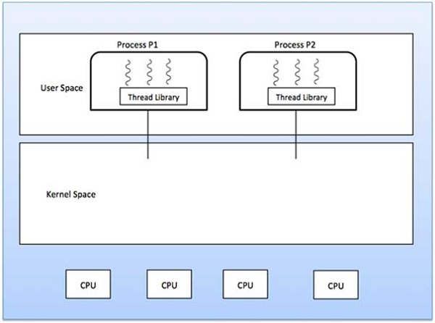
Types of Thread
User Level Threads − User managed threads.
Kernel Level Threads − Operating System managed threads acting on kernel, an operating system core.
User Level Threads
In this case, the thread management kernel is not aware of the existence of threads. The thread library contains code for creating and destroying threads, for passing message and data between threads, for scheduling thread execution and for saving and restoring thread contexts. The application starts with a single thread.

Slide 24
Advantages
Thread switching does not require Kernel mode privileges.
User level thread can run on any operating system.
Scheduling can be application specific in the user level thread.
User level threads are fast to create and manage.
Disadvantages
In a typical operating system, most system calls are blocking.
Multithreaded application cannot take advantage of multiprocessing.

Slide 25
Kernel Level Threads
In this case, thread management is done by the Kernel. There is no thread management code in the application area. Kernel threads are supported directly by the operating system. Any application can be programmed to be multithreaded. All of the threads within an application are supported within a single process.
The Kernel maintains context information for the process as a whole and for individuals threads within the process. Scheduling by the Kernel is done on a thread basis. The Kernel performs thread creation, scheduling and management in Kernel space. Kernel threads are generally slower to create and manage than the user threads.
Advantages
Kernel can simultaneously schedule multiple threads from the same process on multiple processes.
If one thread in a process is blocked, the Kernel can schedule another thread of the same process.
Kernel routines themselves can be multithreaded.
Disadvantages
Kernel threads are generally slower to create and manage than the user threads.
Transfer of control from one thread to another within the same process requires a mode switch to the Kernel.

Slide 26
Multithreading Models
Some operating system provide a combined user level thread and Kernel level thread facility. Solaris is a good example of this combined approach. In a combined system, multiple threads within the same application can run in parallel on multiple processors and a blocking system call need not block the entire process. Multithreading models are three types
Many to many relationship.
Many to one relationship.
One to one relationship.

Slide 27
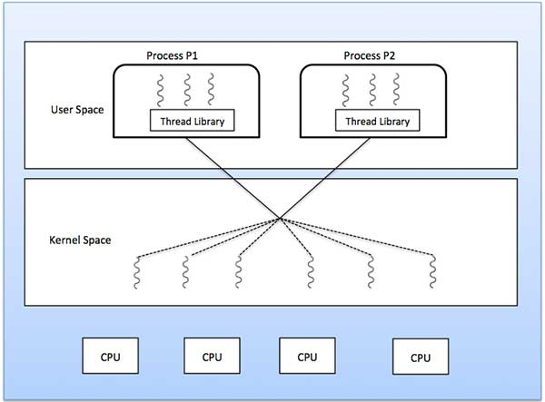
Many to Many Model
The many-to-many model multiplexes any number of user threads onto an equal or smaller number of kernel threads.
The following diagram shows the many-to-many threading model where 6 user level threads are multiplexing with 6 kernel level threads. In this model, developers can create as many user threads as necessary and the corresponding Kernel threads can run in parallel on a multiprocessor machine. This model provides the best accuracy on concurrency and when a thread performs a blocking system call, the kernel can schedule another thread for execution.

Slide 28
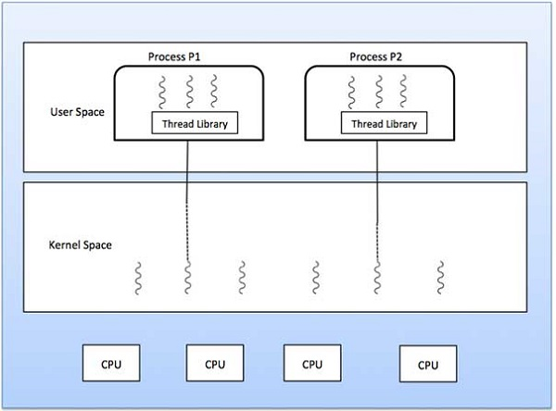
Many to One Model
Many-to-one model maps many user level threads to one Kernel-level thread. Thread management is done in user space by the thread library. When thread makes a blocking system call, the entire process will be blocked. Only one thread can access the Kernel at a time, so multiple threads are unable to run in parallel on multiprocessors.
If the user-level thread libraries are implemented in the operating system in such a way that the system does not support them, then the Kernel threads use the many-to-one relationship modes.

Slide 29
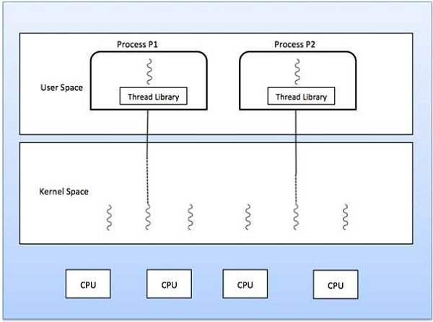
One to One Model
There is one-to-one relationship of user-level thread to the kernel-level thread. This model provides more concurrency than the many-to-one model. It also allows another thread to run when a thread makes a blocking system call. It supports multiple threads to execute in parallel on microprocessors.
Disadvantage of this model is that creating user thread requires the corresponding Kernel thread. OS/2, windows NT and windows 2000 use one to one relationship model.

Slide 30
Difference between User-Level & Kernel-Level Thread
Comparison Basis | Process | Thread
Definition | A process is a program under execution i.e an active program. | A thread is a lightweight process that can be managed independently by a scheduler.
Context switching time | Processes require more time for context switching as they are more heavy. | Threads require less time for context switching as they are lighter than processes.
Memory Sharing | Processes are totally independent and don’t share memory. | A thread may share some memory with its peer threads.
Communication | Communication between processes requires more time than between threads. | Communication between threads requires less time than between processes .
Blocked | If a process gets blocked, remaining processes can continue execution. | If a user level thread gets blocked, all of its peer threads also get blocked.
Resource Consumption | Processes require more resources than threads. | Threads generally need less resources than processes.
Dependency | Individual processes are independent of each other. | Threads are parts of a process and so are dependent.
Data and Code sharing | Processes have independent data and code segments. | A thread shares the data segment, code segment, files etc. with its peer threads.
Treatment by OS | All the different processes are treated separately by the operating system. | All user level peer threads are treated as a single task by the operating system.
Time for creation | Processes require more time for creation. | Threads require less time for creation.
Time for termination | Processes require more time for termination. | Threads require less time for termination.

Slide 31

Threads
The Thread Model (1)
(a) Three processes each with one thread
(b) One process with three threads

Slide 32
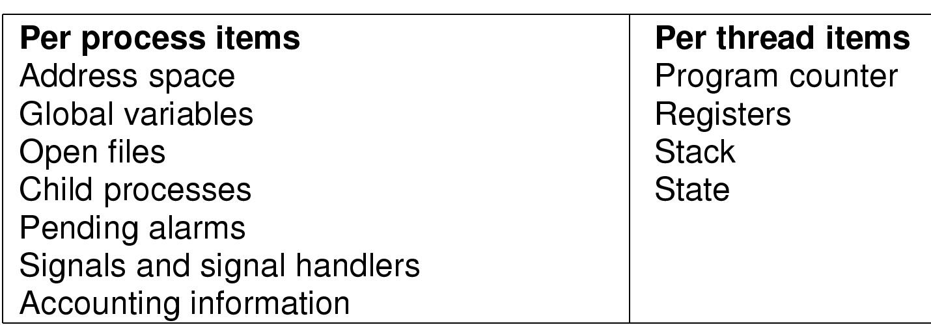
The Thread Model (2)
Items shared by all threads in a process
Items private to each thread

Slide 33

The Thread Model (3)
Each thread has its own stack

Slide 34

Thread Usage (1)
A word processor with three threads

Slide 35

Thread Usage (2)
A multithreaded Web server

Slide 36
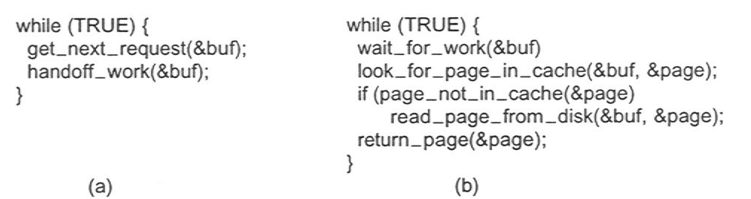
Thread Usage (3)
Rough outline of code for previous slide
  (a) Dispatcher thread
  (b) Worker thread

Slide 37
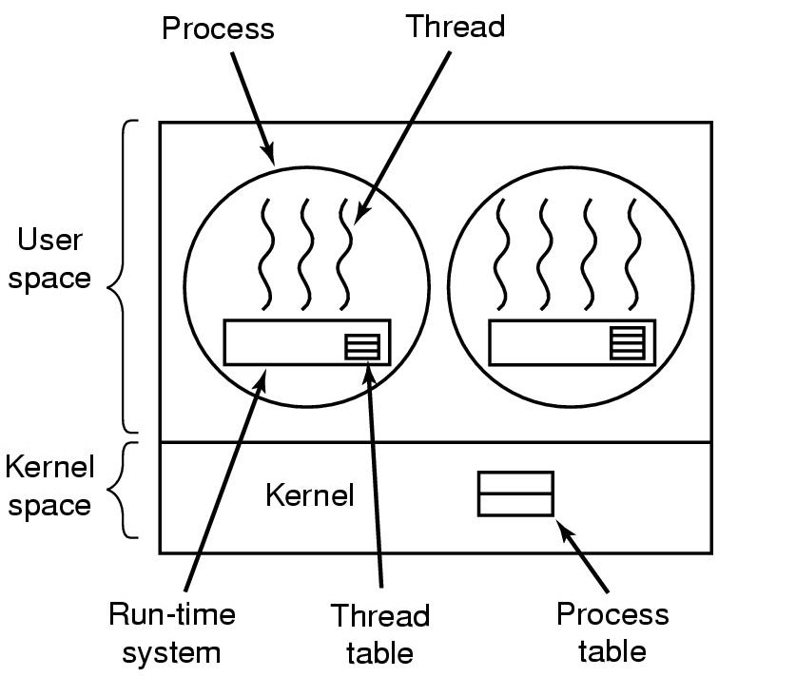
Implementing Threads in User Space
A user-level threads package

Slide 38
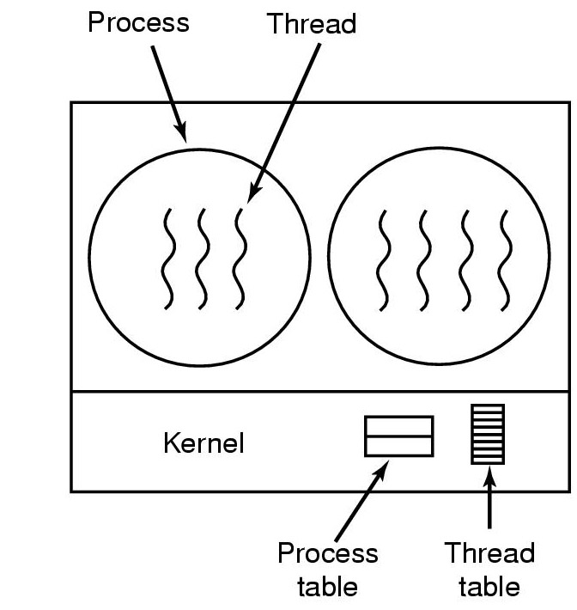
Implementing Threads in the Kernel
A threads package managed by the kernel

Slide 39
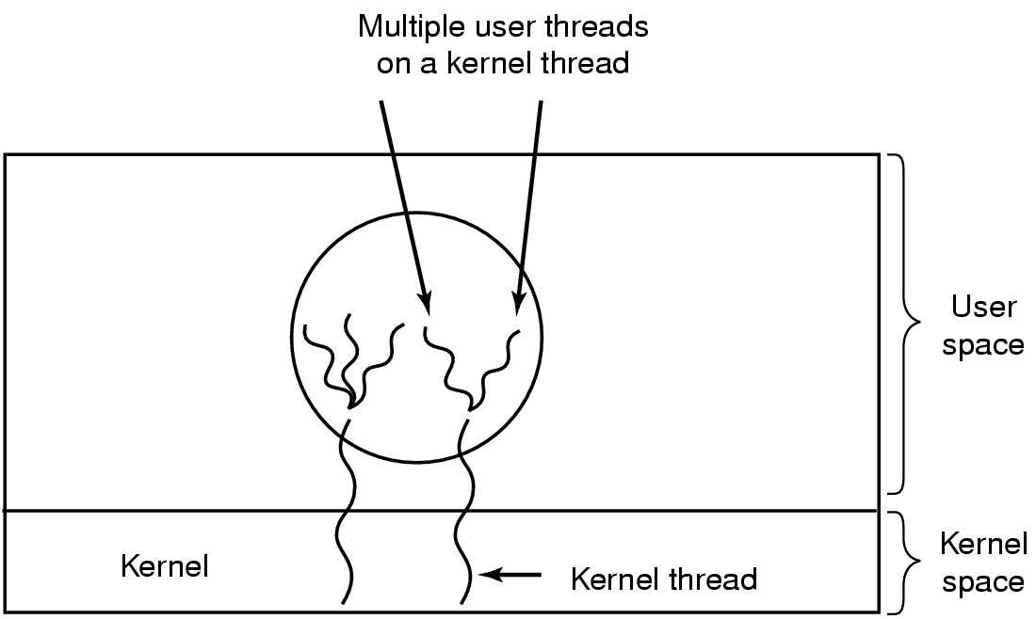
Hybrid Implementations
Multiplexing user-level threads onto kernel- level threads

Slide 40
Scheduler Activations
Goal – mimic functionality of kernel threads
  gain performance of user space threads
Avoids unnecessary user/kernel transitions
Kernel assigns virtual processors to each process
  lets runtime system allocate threads to processors
Problem:
Fundamental reliance on kernel (lower layer)
calling procedures in user space (higher layer)

Slide 41
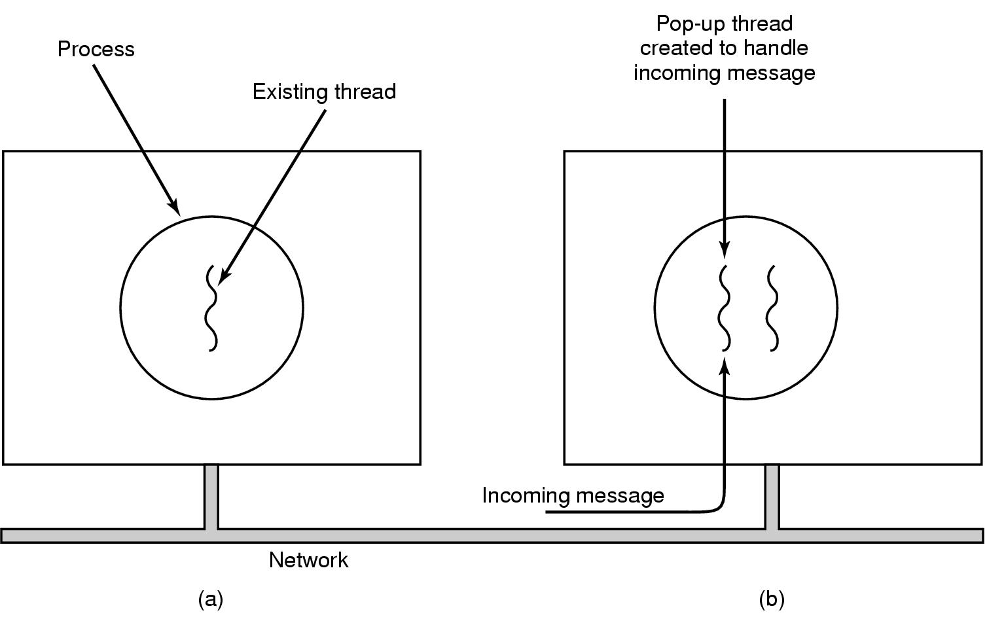
Pop-Up Threads
Creation of a new thread when message arrives
  (a) before message arrives
  (b) after message arrives

Slide 42

2.3 Scheduling
Introduction to Scheduling (1)
Bursts of CPU usage alternate with periods of I/O wait
  a CPU-bound process
  an I/O bound process

Slide 43
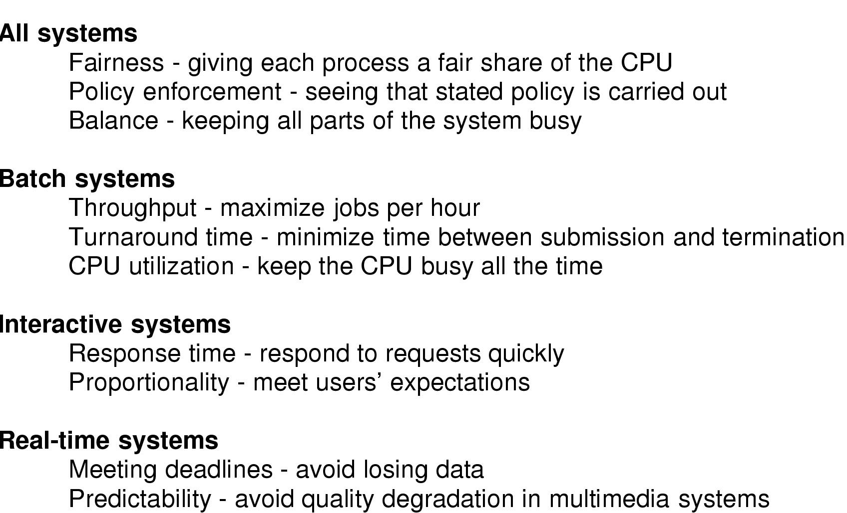
Introduction to Scheduling (2)
Scheduling Algorithm Goals

Slide 44
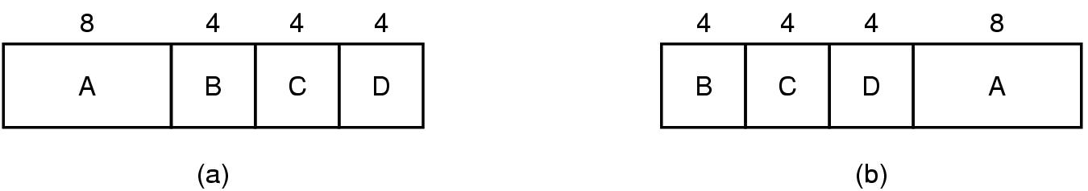
Scheduling in Batch Systems (1)
An example of shortest job first scheduling

Slide 45
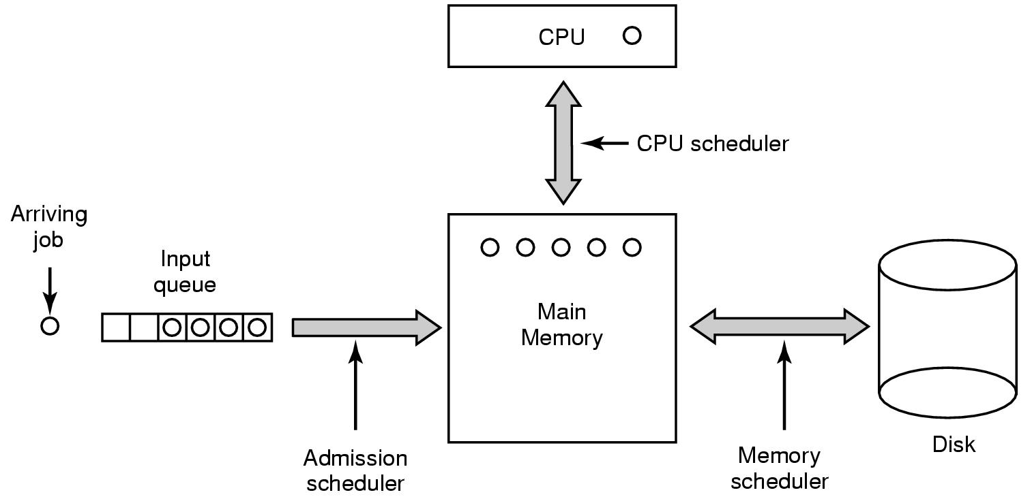
Scheduling in Batch Systems (2)
Three level scheduling

Slide 46
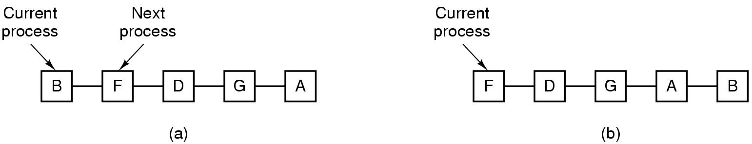
Scheduling in Interactive Systems (1)
Round Robin Scheduling
  list of runnable processes
  list of runnable processes after B uses up its quantum

Slide 47
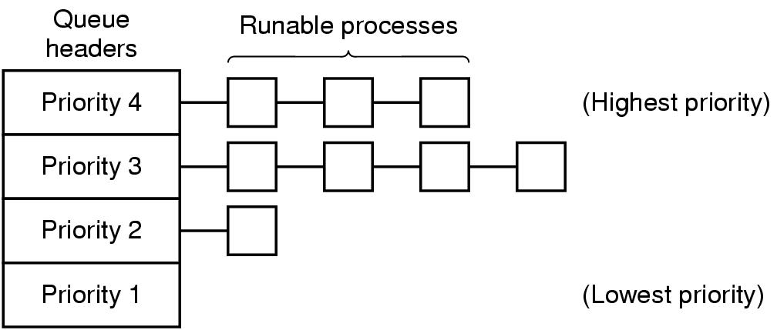
Scheduling in Interactive Systems (2)
A scheduling algorithm with four priority classes

Slide 48
2.4CPU Scheduler
Selects from among the processes in memory that are ready to execute, and allocates the CPU to one of them.
CPU scheduling decisions may take place when a process:
  1. Switches from running to waiting state.
  2. Switches from running to ready state.
  3. Switches from waiting to ready.
  4. Terminates.
Scheduling under 1 and 4 is nonpreemptive.
All other scheduling is preemptive.
Operating System Concepts

Slide 49
2.5 Dispatcher
Dispatcher module gives control of the CPU to the process selected by the short-term scheduler; this involves:
  switching context
  switching to user mode
  jumping to the proper location in the user program to restart that program
Dispatch latency – time it takes for the dispatcher to stop one process and start another running.
Operating System Concepts

Slide 50
2.6 Scheduling Criteria
CPU utilization – keep the CPU as busy as possible
Throughput – # of processes that complete their execution per time unit
Turnaround time – amount of time to execute a particular process
Waiting time – amount of time a process has been waiting in the ready queue
Response time – amount of time it takes from when a request was submitted until the first response is produced, not output (for time-sharing environment)
Operating System Concepts

Slide 51
Optimization Criteria
Max CPU utilization
Max throughput
Min turnaround time
Min waiting time
Min response time
Operating System Concepts

Slide 52
2.6Scheduling Algorithms
Process Burst Time
P₁ 24
P₂ 3
P₃ 3
Suppose that the processes arrive in the order: P₁ , P₂ , P₃ The Gantt Chart for the schedule First-Come, First-Served (FCFS) is:
Waiting time for P₁ = 0; P₂ = 24; P₃ = 27
Average waiting time: (0 + 24 + 27)/3 = 17
P₁
P₂
P₃
0
24
27
30
Operating System Concepts

Slide 53
Enter number of processors: 3
Enter the Burst Time of the process 1: 2
Enter the Burst Time of the process 2: 5
Enter the Burst Time of the process 3: 4
Process ID Waiting Time Turn Around Time
P1 0 2
P 2 2 7
P3 7 11
Average Waiting Time =(0+2+7)=9/3=3.00
Average Turnaround Time= (2+7+11)/3=20/3= 6.67
FIRST COME FIRST SERVE SCHEDULING ALGORITHM
P1
P2
P3
0
2
7
11

Slide 54
FCFS Scheduling (Cont.)
Suppose that the processes arrive in the order
P₂ , P₃ , P₁ .
The Gantt chart for the schedule is:
Waiting time for P₁ = 6; P₂ = 0; P₃ = 3
Average waiting time: (6 + 0 + 3)/3 = 3
Much better than previous case.
Convoy effect short process behind long process
P₂
P₃
P₁
0
3
6
30
Operating System Concepts

Slide 55
Advantages of FCFS
Here, are pros/benefits of using FCFS scheduling algorithm:
The simplest form of a CPU scheduling algorithm
Easy to program
First come first served
Disadvantages of FCFS
Here, are cons/ drawbacks of using FCFS scheduling algorithm:
It is a Non-Preemptive CPU scheduling algorithm, so after the process has been allocated to the CPU, it will never release the CPU until it finishes executing.
The Average Waiting Time is high.
Short processes that are at the back of the queue have to wait for the long process at the front to finish.
Not an ideal technique for time-sharing systems.
Because of its simplicity, FCFS is not very efficient.

Slide 56
Shortest-Job-First (SJR) Scheduling
Associate with each process the length of its next CPU burst. Use these lengths to schedule the process with the shortest time.
Two schemes:
  nonpreemptive – once CPU given to the process it cannot be preempted until completes its CPU burst.
  preemptive – if a new process arrives with CPU burst length less than remaining time of current executing process, preempt. This scheme is know as the
  Shortest-Remaining-Time-First (SRTF).
SJF is optimal – gives minimum average waiting time for a given set of processes.
Operating System Concepts

Slide 57
Example of Non-Preemptive SJF
Process Arrival Time Burst Time
P₁ 0.0 7 7
P₂ 2.0 4 12
P₃ 4.0 1 8
P₄ 5.0 4 16
SJF (non-preemptive)
Average waiting time = (0 + 6 + 3 + 7)/4 - 4
P₁
P₃
P₂
P₄
0
3
7
8
12
16
Operating System Concepts

Slide 58
Example of Preemptive SJF
Process Arrival Time Burst Time
P₁ 0.0 7-2 = 5
P₂ 2.0 4-2= 2
P₃ 4.0 1-1= 0
P₄ 5.0 4
Average waiting time = (9 + 1 + 0 +2)/4 - 3
P₁
P₂
P₃
P₂
P₄
P₁
0
2
4
5
7
11
16
Operating System Concepts

Slide 59

Turn Around Time = Completion Time - Arrival Time
Waiting Time = Turnaround time - Burst Time
Process ID | Arrival Time | Burst Time | Completion Time | Turn Around Time | Waiting Time
P0 | 0 | 2 | 2 | 2 | 0
P1 | 1 | 6 | 8 | 7 | 1
P2 | 2 | 4 | 12 | 8 | 4
P3 | 3 | 9 | 21 | 18 | 9
P4 | 4 | 12 | 33 | 29 | 17
Avg Waiting Time=31/5

Slide 60
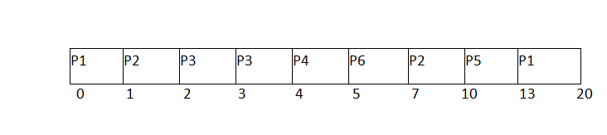
Shortest Remaining Time First (SRTF) Scheduling Algorithm
Process ID | Arrival Time | Burst Time | Completion Time | Turn Around Time | Waiting Time | Response Time
1 | 0 | 8 | 20 | 20 | 12 | 0
2 | 1 | 4 | 10 | 9 | 5 | 1
3 | 2 | 2 | 4 | 2 | 0 | 2
4 | 3 | 1 | 5 | 2 | 1 | 4
5 | 4 | 3 | 13 | 9 | 6 | 10
6 | 5 | 2 | 7 | 2 | 0 | 5
Avg Waiting Time = 24/6

Slide 61

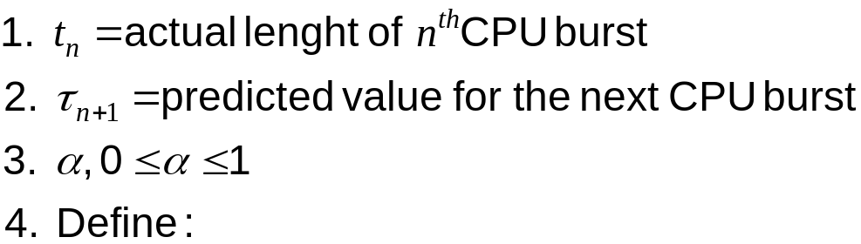
Determining Length of Next CPU Burst
Can only estimate the length.
Can be done by using the length of previous CPU bursts, using exponential averaging.
Operating System Concepts

Slide 62
Priority Scheduling
A priority number (integer) is associated with each process
The CPU is allocated to the process with the highest priority (smallest integer ≡ highest priority).
  Preemptive
  nonpreemptive
SJF is a priority scheduling where priority is the predicted next CPU burst time.
Problem ≡ Starvation – low priority processes may never execute.
Solution ≡ Aging – as time progresses increase the priority of the process.
Operating System Concepts

Slide 63
Round Robin (RR)
Each process gets a small unit of CPU time (time quantum), usually 10-100 milliseconds. After this time has elapsed, the process is preempted and added to the end of the ready queue.
If there are n processes in the ready queue and the time quantum is q, then each process gets 1/n of the CPU time in chunks of at most q time units at once. No process waits more than (n-1)q time units.
Performance
  q large ⇒ FIFO
  q small ⇒ q must be large with respect to context switch, otherwise overhead is too high.
Operating System Concepts

Slide 64
Example of RR with Time Quantum = 4
Process Burst Time
P₁ 24
P₂ 3
P₃ 3
Waiting Time:
  P1: (10-4) = 6
  P2: (4-0) = 4
  P3: (7-0) = 7
Completion Time:
  P1: 30 P2: 7 P3: 10
Average Waiting Time: (6 + 4 + 7)/3= 5.67
Average Completion Time: (30+7+10)/3=15.67
P₁
P₂
P₃
P₁
P₁
P₁
P₁
P₁
0
4
7
10
14
18
22
26
30

Slide 65
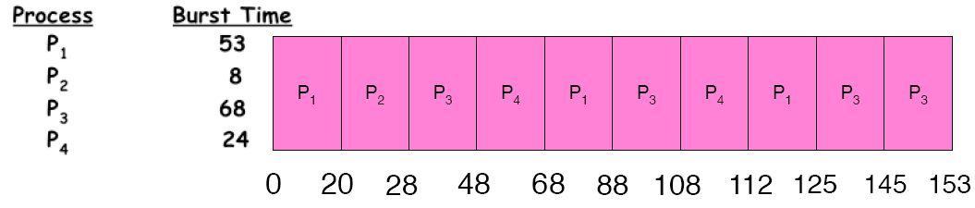
Example of RR with Time Quantum = 20
Waiting Time:
  P1: (68-20)+(112-88) = 72
  P2: (20-0) = 20
  P3: (28-0)+(88-48)+(125-108) = 85
  P4: (48-0)+(108-68) = 88
Completion Time:
  P1: 125
  P2: 28
  P3: 153
  P4: 112
Average Waiting Time: (72+20+85+88)/4 = 66.25
Average Completion Time: (125+28+153+112)/4 = 104.5
A process can finish before the time quantum expires, and release the CPU.

Slide 66

Time Quantum and Context Switch Time
Operating System Concepts

Slide 67

Turnaround Time Varies With The Time Quantum
Operating System Concepts

Slide 68
Multilevel Queue
Ready queue is partitioned into separate queues:
foreground (interactive)
background (batch)
Each queue has its own scheduling algorithm,
foreground – RR
background – FCFS
Scheduling must be done between the queues.
  Fixed priority scheduling; (i.e., serve all from foreground then from background). Possibility of starvation.
  Time slice – each queue gets a certain amount of CPU time which it can schedule amongst its processes; i.e., 80% to foreground in RR
  20% to background in FCFS
Operating System Concepts

Slide 69

Multilevel Queue Scheduling
Operating System Concepts

Slide 70
Multilevel Feedback Queue
A process can move between the various queues; aging can be implemented this way.
Multilevel-feedback-queue scheduler defined by the following parameters:
  number of queues
  scheduling algorithms for each queue
  method used to determine when to upgrade a process
  method used to determine when to demote a process
  method used to determine which queue a process will enter when that process needs service
Operating System Concepts

Slide 71
2.7 Process Management in UNIX
Define & implement the essential characteristics of a process and thread
  Algorithms to define the behavior
  Data structures to preserve the state of the execution
Define what “things” threads in the process can reference – the address space (most of the “things” are memory locations)
Manage the resources used by the processes/threads
Tools to create/destroy/manipulate processes & threads
Tools to time-multiplex the CPU – Scheduling the (Chapter 7)
Tools to allow threads to synchronization the operation with one another (Chapters 8-9)
Mechanisms to handle deadlock (Chapter 10)

Slide 72
External View of the OS
wait()
close()
sleep()
File Mgr
Hardware
C
Program
fork()
signal()
Device Mgr
semctl()
Memory Mgr
SetWaitableTimer()
CreateProcess()
Process Mgr
CreateThread()
OS
CloseHandle()
WaitForSingleObject()

Slide 73
Initializing the Machine
Power up ⇒ fetch-execute cycle begins
Initial (or hardware) process begins to run
Executes ROM diagnostic program
Then bootstrap loads the OS
OS initialization
  Setup & initialize all system data structures (this creates process & resource abstractions)
  Initialize all devices
  Start daemons – including idle process
  Branches to the scheduler

Slide 74
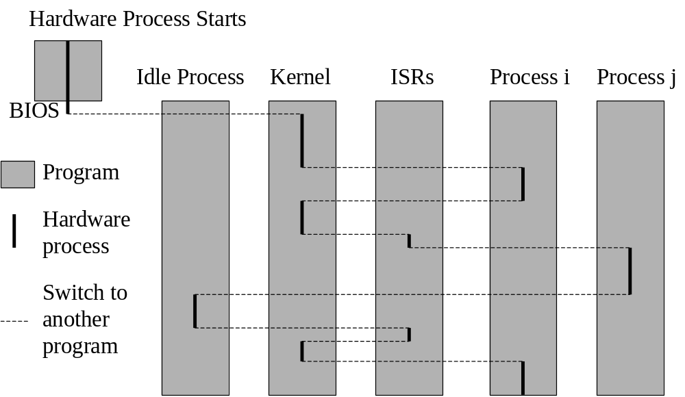

Slide 75
Process Abstraction Layers
Process Mgr
p_{i}, p_{j}, and p_{k} each have their own virtual terminal
P_{i}
Virt Term
P_{j}
Virt Term
P_{k}
Virt Term
Window Mgr interface
P_{i}
Control
Unit
P_{j}
Control
Unit
P_{k}
Control
Unit
p_{i}, p_{j}, and p_{k} each have their own virtual machine
OS interface
OS
Address
Space
P_{i}
Address
Space
Hardware process (OS) coroutines across p_{i}, p_{j}, and p_{k} under OS control
Control
Unit
P_{k}
Address
Space
P_{j}
Address
Space

Slide 76
Process Manager Overview
Process Mgr
Program
Process
Abstract Computing Environment
File
Manager
Deadlock
Process
Description
Protection
Synchronization
Device
Manager
Memory
Manager
Resource
Manager
Scheduler
Resource
Manager
Resource
Manager
Devices
Memory
CPU
Other H/W

Slide 77
Unix Organization
Process
Libraries
Process
Process
System Call Interface
File
Manager
Deadlock
Process
Description
Protection
Synchronization
Device
Manager
Memory
Manager
Resource
Manager
Scheduler
Resource
Manager
Resource
Manager
Monolithic Kernel
Devices
Memory
CPU
Other H/W

Slide 78
Creating a Process in UNIX
pid = fork();
UNIX kernel
Process Table
…
Process Descriptor

